Slide 1
AZ-104T00A Module 01: Identity

Slide 2
Module Overview
Lesson 01: Azure Active Directory
Lesson 02: Users and Groups
Lesson 03: Module 01 Lab and Review

Slide 3
Lesson 01: Azure Active Directory

Slide 4
Azure Active Directory Overview
Azure Active Directory
Azure AD Concepts
AD DS vs. Azure Active Directory
Azure Active Directory Editions
Azure AD Join
Multi-Factor Authentication
Self-Service Password Reset
Notes:
Lesson overview

Slide 5
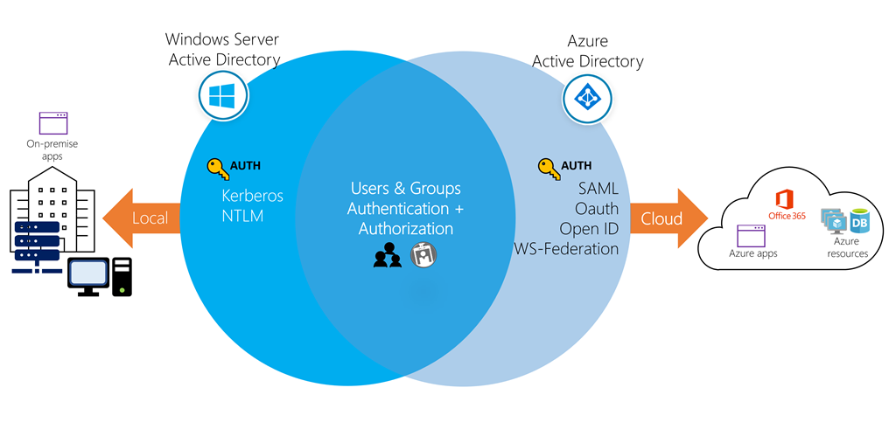
Azure Active Directory
A cloud-based suite of identity management capabilities that enables you to securely manage access to Azure services and resources for your users
Provides application management, authentication, device management, and hybrid identity
Notes:
Azure Active Directory Documentation - https://docs.microsoft.com/en-us/azure/active-directory/
a cloud identity and access management solution that safeguards your data called azure AD.

Slide 6
Azure AD Concepts
Concept | Description
Identity | An object that can be authenticated.
Account | An identity that has data associated with it.
Azure AD Account | An identity created through Azure AD or another Microsoft cloud service.
Azure tenant | A dedicated and trusted instance of Azure AD that's automatically created when your organization signs up for a Microsoft cloud service subscription.
Azure AD directory | Each Azure tenant has a dedicated and trusted Azure AD directory.
User subscription | Used to pay for Azure cloud services.

Slide 7
AD DS vs Azure Active Directory
Azure AD is primarily an identity solution, and designed for HTTP and HTTPS communications
Queried using the REST API (Representational State Transfer) over HTTP and HTTPS. Instead of LDAP.
Uses HTTP and HTTPS protocols such as SAML, WS-Federation, and OpenID Connect for authentication (and OAuth for authorization). Instead of Kerberos
Includes federation services, and many third-party services (such as Facebook)
Azure AD users and groups are created in a flat structure, and there are no Organizational Units (OUs) or Group Policy Objects (GPOs)
Notes:
✔️ Azure AD is a managed service. You only manage the users, groups, and policies. Deploying AD DS with virtual machines using Azure means that you manage the deployment, configuration, virtual machines, patching, and other backend tasks. Do you see the difference? How are they similar?

Slide 8
Azure Active Directory Editions
Feature | Free | Office 365 Apps | Premium P1 | Premium P2
Directory Objects | 500,000 objects | No object limit | No object limit | No object limit
Single Sign-On | Up to 10 apps | Up to 10 apps | Unlimited | Unlimited
Core Identity and Access | X | X | X | X
B2B Collaboration | X | X | X | X
Identity & Access for O365 |  | X | X | X
Premium Features |  |  | X | X
Hybrid Identities |  |  | X | X
Advanced Group Access |  |  | X | X
Conditional Access |  |  | X | X
Identity Protection |  |  |  | X
Identity Governance |  |  |  | X
Notes:
✔️ Did you look through the pricing list to determine which features your organization needs and to compare edition capabilities?
Azure AD Pricing Editions - https://azure.microsoft.com/en-us/pricing/details/active-directory/

Slide 9
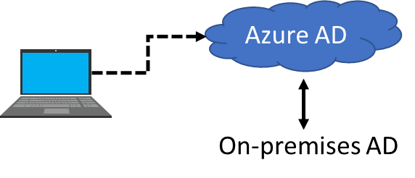
Azure AD Join
Single-Sign-On to your Azure managed SaaS apps and services
Enterprise compliant roaming of user settings across joined devices
Access to Microsoft Store for Business
Windows Hello support
Restriction of access to apps from only compliant devices
Seamless access to on-premise resources
Notes:
✔️ Although AD Join is intended for organizations that do not have on-premises Windows Server Active Directory infrastructure it can be used for other scenarios like branch offices.

Slide 10
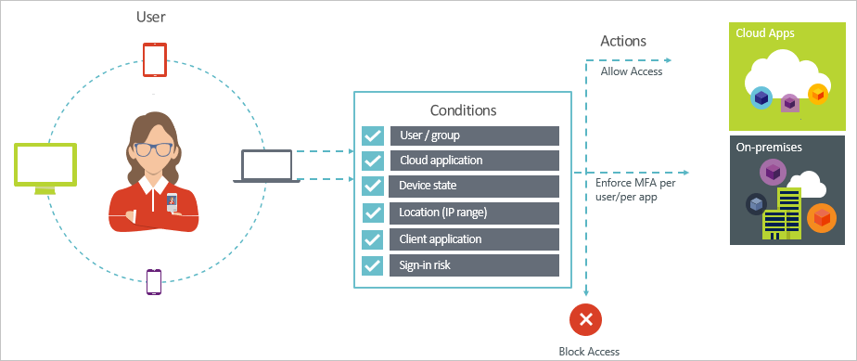
Multi-Factor Authentication
Conditions – “When this happens”
Access controls – “Then do this”
Provides two step authentication verification
Lets you enforce controls on access to apps based on specific conditions
Notes:
✔️ Do you think conditional access would be something your organization is interested in?

Slide 11
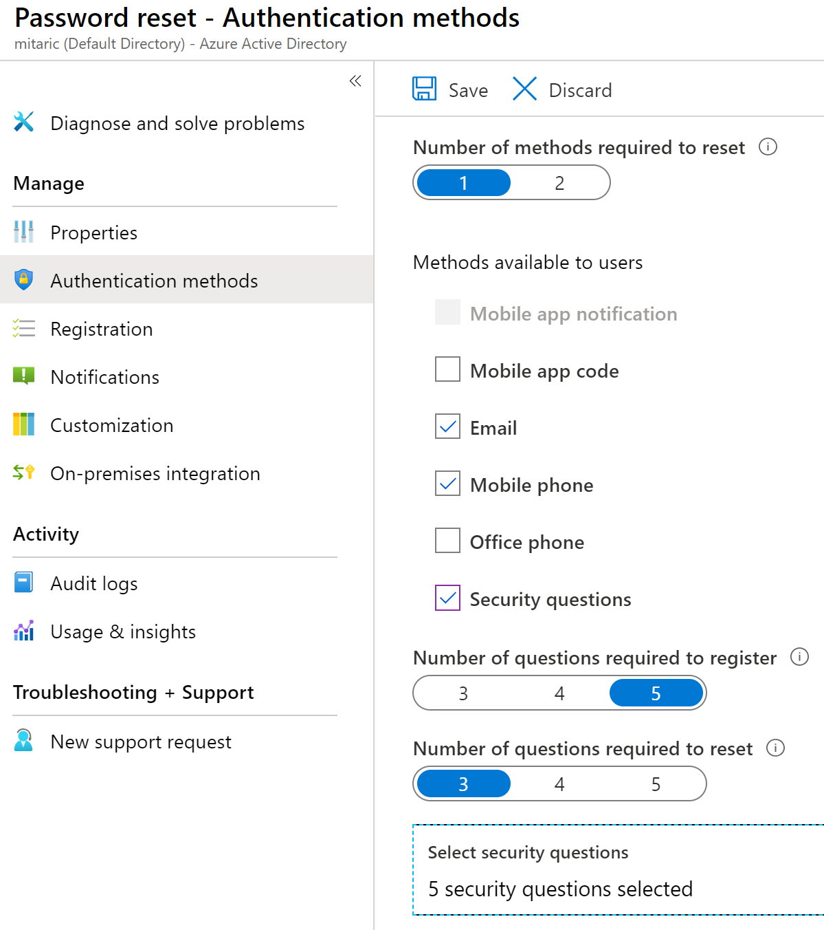
Self-Service Password Reset
Determine who can use self-service password reset
Choose the number of authentication methods required and the methods available (email, phone, questions)
You can require users to register for SSPR (same process as MFA)
1
2
3

Slide 12
Lesson 02: Users and Groups

Slide 13
Users and Groups Overview
User Accounts
Managing User Accounts
Bulk User Accounts
Group Accounts
Azure AD Connect
Azure AD Connect Health
Azure AD B2B and B2C
Demonstration – Users and Groups
Notes:
Lesson overview

Slide 14
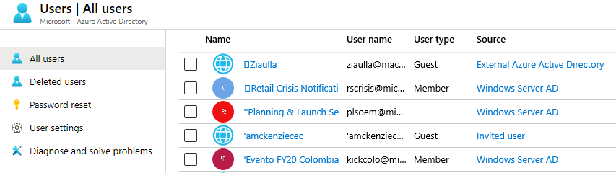
User Accounts
All users must have an account
The account is used for authentication and authorization
Identity Sources: Cloud, Directory-synchronized, and Guest
Notes:
✔️ Have you given any thought as to the type of users you will need?

Slide 15
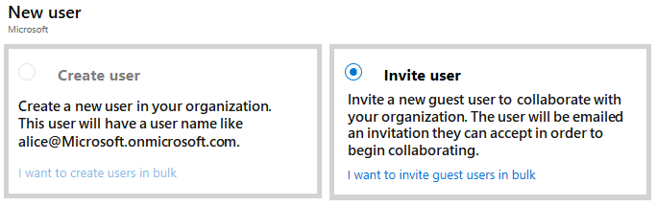
Managing User Accounts
Must be Global Administrator to manage users
User profile (picture, job, contact info) is optional
Deleted users can be restored for 30 days
Sign in and audit log information is available

Slide 16
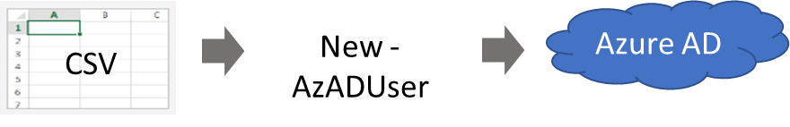
Bulk User Accounts
Create the comma-separated values (CSV) file with the list of all the users and their properties
Loop through the file processing each user
Consider error handling, duplicate users, initial password settings, empty properties, and when the account is enabled
✔️ Bulk invite Azure AD B2B collaboration users is in Preview
Notes:
✔️ Establish or implement a naming convention for usernames, display names and aliases. The password for the new users needs to conform to the password complexity rules you have set for your directory. User parameters include User Principal Name, Display Name, Given Name, Department, and Job Title.
Tutorial: Bulk invite Azure AD B2B collaboration users (disabled as of 12/2019) - https://github.com/MicrosoftDocs/azure-docs/blob/master/articles/active-directory/b2b/tutorial-bulk-invite.md
Importing data into my directory - https://docs.microsoft.com/en-us/powershell/azure/active-directory/importing-data?view=azureadps-2.0

Slide 17
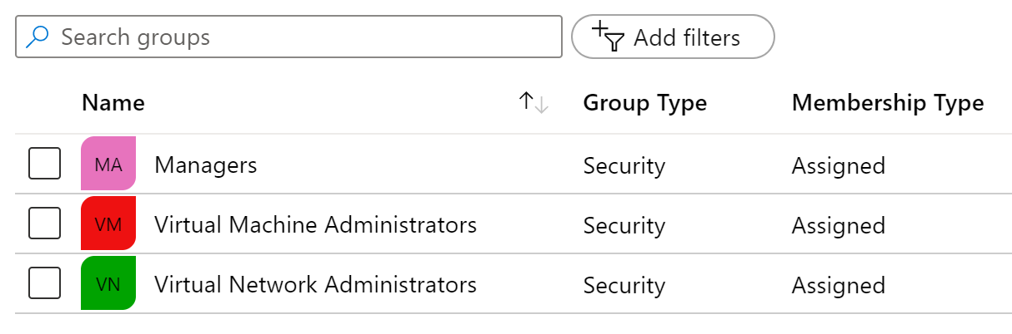
Group Accounts
Group Types
Security groups
Office 365 groups
Assignment Types
Assigned
Dynamic User
Dynamic Device (Security groups only)
Notes:
✔️ Have you given any thought to which groups you need to create? How will you assign users to groups?

Slide 18
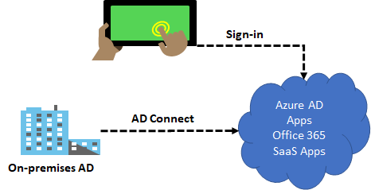
Azure AD Connect
Integrate your on-premises directories with Azure Active Directory
Provides a common identity for your users for Office 365, Azure, and SaaS applications integrated with Azure AD
There are several authentication options – password hash synchronization and pass-through authentication

Slide 19
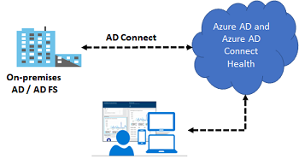
Azure AD Connect Health
Monitor and gain insights into AD FS servers, Azure AD Connect, and AD domain controllers
Monitor and gain insights into the synchronizations that occur between your on-premises AD DS and Azure AD
Monitor and gain insights into your on-premises identity infrastructure that is used to access Office 365 or other Azure AD applications

Slide 20
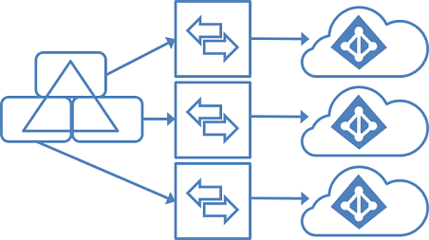
Managing Multiple Directories
In Azure Active Directory (Azure AD), each tenant is a fully independent resource
There is no parent-child relationship between tenants
This independence between tenants includes resource, administrative, and synchronization
✔️ It is recommended to use a supported synchronization configuration

Slide 21



Azure AD B2B and B2C
Business to Business (B2B)
Inviting users from other Azure AD Tenants into your own organization tenant
User provisioning is done by the invited party
Business to Consumer (B2C)
Inviting users from other social media Identity Tenants into your own organization tenant
User provisioning is done by the invited party; you are in control to invite the other side’s users

Slide 22
Demonstration – Users and Groups
Determine domain information
Explore user accounts
Explore group accounts
Explore PowerShell for group management
Notes:
✔ Always consider having students walk-through the demonstrations themselves. Also, consider the overlap with the formal labs and your best use of time.

Slide 23
Lesson 03: Module 01 Lab and Review

Slide 24
Lab 01 - Manage Azure Active Directory Identities
Lab scenario
In order to allow Contoso users to authenticate by using Azure AD, you have been tasked with provisioning users and group accounts. Membership of the groups should be updated automatically based on the user job titles. You also need to create a test Azure AD tenant with a test user account and grant that account limited permissions to resources in the Contoso Azure subscription.
Objectives
Task 1: Create and configure Azure AD users
Task 2: Create Azure AD groups with assigned and dynamic membership
Task 3: Create an Azure Active Directory (AD) tenant
Task 4: Manage Azure AD guest users

Slide 25
Module Review
Module Review Questions
Microsoft Learn Modules (docs.microsoft.com/Learn)
Create Azure users and groups in Azure Active Directory
Manage users and groups in Azure Active Directory
Secure your Azure resources with role-based access control (RBAC)
Secure Azure Active Directory users with Multi-Factor Authentication
Allow users to reset their password with Azure Active Directory self-service password reset
Secure your application by using OpenID Connect and Azure AD
Notes:
https://docs.microsoft.com/en-us/learn/modules

